Slide 1
Signals & Systems Concepts
(1) Systems, signals, mathematical models. Continuous-time and discrete-time signals and systems. Energy and power signals. Linear systems. Examples for use throughout the course, introduction to Matlab and Simulink tools
Specific Objectives:
Introduce, using examples, what is a signal and what is a system
Why mathematical models are appropriate
What are continuous-time and discrete-time representations and how are they related
Brief introduction to Matlab and Simulink

Slide 2
What is a Signal?
A signal is a pattern of variation of some form
Signals are variables that carry information
Examples of signal include:
Electrical signals
  Voltages and currents in a circuit
Acoustic signals
  Acoustic pressure (sound) over time
Mechanical signals
  Velocity of a car over time
Video signals
  Intensity level of a pixel (camera, video) over time

Slide 3
How is a Signal Represented?
Mathematically, signals are represented as a function of one or more independent variables.
For instance a black & white video signal intensity is dependent on x, y coordinates and time t f(x,y,t)
On this course, we shall be exclusively concerned with signals that are a function of a single variable: time
f(t)
t

Slide 4
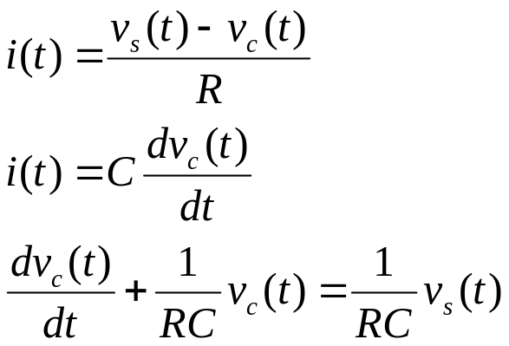
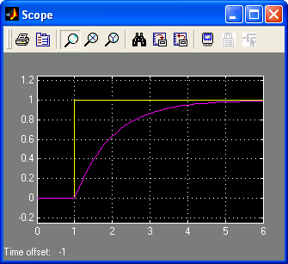
Example: Signals in an Electrical Circuit
R
v_{s}
+
-
i
C
v_{c}
The signals v_{c} and v_{s} are patterns of variation over time
Note, we could also have considered the voltage across the resistor or the current as signals
Step (signal) v_{s} at t=1
RC = 1
First order (exponential) response for v_{c}
v_{s}, v_{c}
t

Slide 5
Continuous & Discrete-Time Signals
Continuous-Time Signals
Most signals in the real world are continuous time, as the scale is infinitesimally fine.
Eg voltage, velocity,
Denote by x(t), where the time interval may be bounded (finite) or infinite
Discrete-Time Signals
Some real world and many digital signals are discrete time, as they are sampled
E.g. pixels, daily stock price (anything that a digital computer processes)
Denote by x[n], where n is an integer value that varies discretely
Sampled continuous signal x[n] =x(nk) – k is sample time
x(t)
t
x[n]
n

Slide 6
Signal Properties
On this course, we shall be particularly interested in signals with certain properties:
Periodic signals: a signal is periodic if it repeats itself after a fixed period T, i.e. x(t) = x(t+T) for all t. A sin(t) signal is periodic.
Even and odd signals: a signal is even if x(-t) = x(t) (i.e. it can be reflected in the axis at zero). A signal is odd if x(-t) = -x(t). Examples are cos(t) and sin(t) signals, respectively.
Exponential and sinusoidal signals: a signal is (real) exponential if it can be represented as x(t) = Ce^{at}. A signal is (complex) exponential if it can be represented in the same form but C and a are complex numbers.
Step and pulse signals: A pulse signal is one which is nearly completely zero, apart from a short spike, δ(t). A step signal is zero up to a certain time, and then a constant value after that time, u(t).
These properties define a large class of tractable, useful signals and will be further considered in the coming lectures

Slide 7
What is a System?
Systems process input signals to produce output signals
Examples:
  A circuit involving a capacitor can be viewed as a system that transforms the source voltage (signal) to the voltage (signal) across the capacitor
  A CD player takes the signal on the CD and transforms it into a signal sent to the loud speaker
  A communication system is generally composed of three sub-systems, the transmitter, the channel and the receiver. The channel typically attenuates and adds noise to the transmitted signal which must be processed by the receiver

Slide 8
How is a System Represented?
A system takes a signal as an input and transforms it into another signal
In a very broad sense, a system can be represented as the ratio of the output signal over the input signal
  That way, when we “multiply” the system by the input signal, we get the output signal
  This concept will be firmed up in the coming weeks
Input signal
x(t)
System
Output signal
y(t)

Slide 9

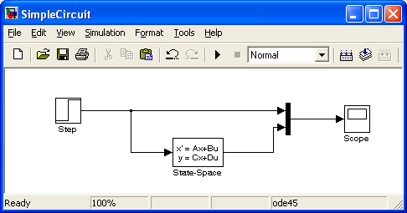
Example: An Electrical Circuit System
R
v_{s}
+
-
i
C
v_{c}
Simulink representation of the electrical circuit
v_{s}(t)
v_{c}(t)
v_{s}, v_{c}
first order
system
t

Slide 10
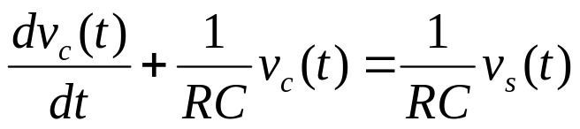
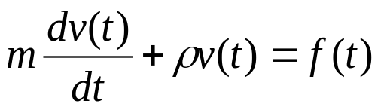

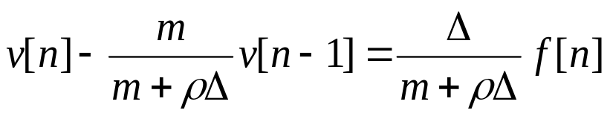
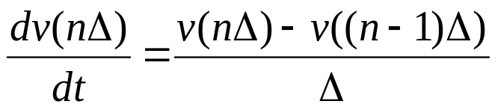
Continuous & Discrete-Time Mathematical Models of Systems
Continuous-Time Systems
Most continuous time systems represent how continuous signals are transformed via differential equations.
E.g. circuit, car velocity
Discrete-Time Systems
Most discrete time systems represent how discrete signals are transformed via difference equations
E.g. bank account, discrete car velocity system
First order differential equations
First order difference equations

Slide 11
Properties of a System
On this course, we shall be particularly interested in signals with certain properties:
Causal: a system is causal if the output at a time, only depends on input values up to that time.
Linear: a system is linear if the output of the scaled sum of two input signals is the equivalent scaled sum of outputs
Time-invariance: a system is time invariant if the system’s output is the same, given the same input signal, regardless of time.
These properties define a large class of tractable, useful systems and will be further considered in the coming lectures

Slide 12
How Are Signal & Systems Related (i)?
How to design a system to process a signal in particular ways?
Design a system to restore or enhance a particular signal
  Remove high frequency background communication noise
  Enhance noisy images from spacecraft
Assume a signal is represented as
  x(t) = d(t) + n(t)
Design a system to remove the unknown “noise” component n(t), so that y(t) ≈ d(t)
x(t) = d(t) + n(t)
System
?
y(t) ≈ d(t)

Slide 13
How Are Signal & Systems Related (ii)?
How to design a system to extract specific pieces of information from signals
  Estimate the heart rate from an electrocardiogram
  Estimate economic indicators (bear, bull) from stock market values
Assume a signal is represented as
  x(t) = g(d(t))
Design a system to “invert” the transformation g(), so that y(t) = d(t)
x(t) = g(d(t))
System
?
y(t) = d(t) = g⁻¹(x(t))

Slide 14
How Are Signal & Systems Related (iii)?
How to design a (dynamic) system to modify or control the output of another (dynamic) system
  Control an aircraft’s altitude, velocity, heading by adjusting throttle, rudder, ailerons
  Control the temperature of a building by adjusting the heating/cooling energy flow.
Assume a signal is represented as
  x(t) = g(d(t))
Design a system to “invert” the transformation g(), so that y(t) = d(t)
x(t)
dynamic
system ?
y(t) = d(t)

